Slide 1
Predicting Deer Age via Computer Vision
9/25/2025

Slide 3
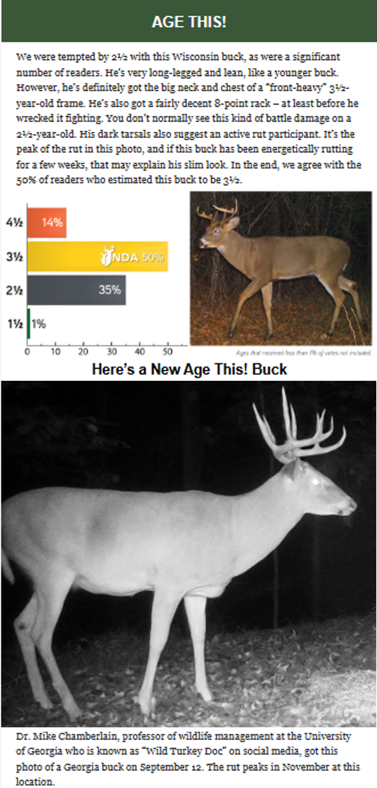
Data : “Age This!” Survey
The National Deer Association (NDA) publishes a weekly “Age This!” survey
Readers are given a trail camera image of a whitetail buck, asking readers to predict its age.
The following week’s newsletter provides the NDA’s prediction/reasoning and voting scores
Notes:
In addition to other resources (ex. Youtube, Facebook, etc.), the National Deer Association’s “Age This!” surveys provide much of the initial data.
Each week, results from the previous week’s survey provide two items:
An aged deer photo with explanation of why the decision was made
Statistics on how others voted for the previous week’s survey.
The former provides images, its metadata stored within the filename for each image.
The latter provides statistics for human prediction accuracy, also collected for each image.

Slide 4
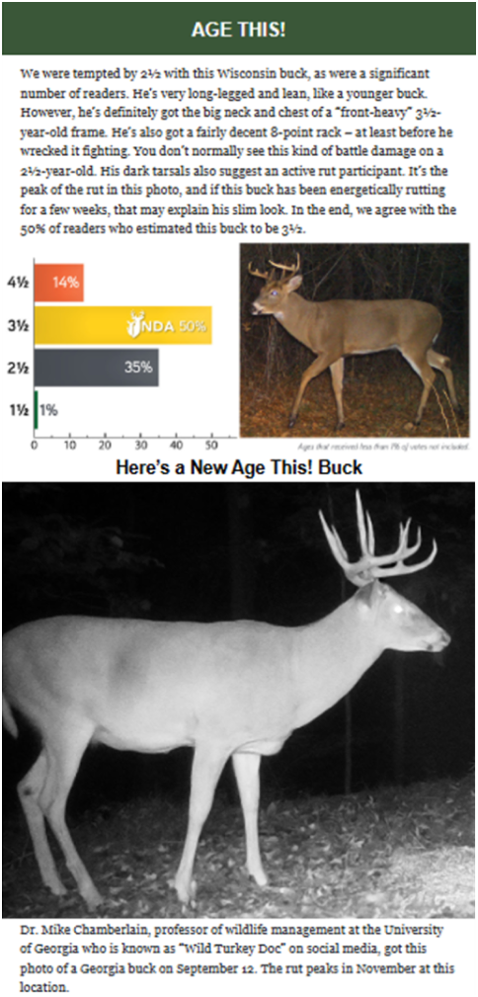
Data : “Age This!” Survey
The National Deer Association (NDA) publishes a weekly “Age This!” survey
Readers are given a trail camera image of a whitetail buck, asking readers to predict its age.
The following week’s newsletter provides the NDA’s prediction/reasoning and voting scores
From an ML perspective, the survey provides:
An image dataset
Time / location information (“metadata”)
Notes:
In addition to other resources (ex. Youtube, Facebook, etc.), the National Deer Association’s “Age This!” surveys provide much of the initial data.
Each week, results from the previous week’s survey provide two items:
An aged deer photo with explanation of why the decision was made
Statistics on how others voted for the previous week’s survey.
The former provides images, its metadata stored within the filename for each image.
The latter provides statistics for human prediction accuracy, also collected for each image.

Slide 5
Data : “Age This!” Survey
The National Deer Association (NDA) publishes a weekly “Age This!” survey
Readers are given a trail camera image of a whitetail buck, asking readers to predict its age.
The following week’s newsletter provides the NDA’s prediction/reasoning and voting scores
From an ML perspective, the survey provides:
An image dataset
Time / location information (“metadata”)
Truth values for each image (“labels”)
Long-term accuracy statistics
Notes:
In addition to other resources (ex. Youtube, Facebook, etc.), the National Deer Association’s “Age This!” surveys provide much of the initial data.
Each week, results from the previous week’s survey provide two items:
An aged deer photo with explanation of why the decision was made
Statistics on how others voted for the previous week’s survey.
The former provides images, its metadata stored within the filename for each image.
The latter provides statistics for human prediction accuracy, also collected for each image.

Slide 6
Data : “Age This!” Survey
The National Deer Association (NDA) publishes a weekly “Age This!” survey
Readers are given a trail camera image of a whitetail buck, asking readers to predict its age.
The following week’s newsletter provides the NDA’s prediction/reasoning and voting scores
From an ML perspective, the survey provides:
An image dataset
Time / location information (“metadata”)
Truth values for each image (“labels”)
Long-term accuracy statistics
Written decision reasoning (“corpus”)
Notes:
In addition to other resources (ex. Youtube, Facebook, etc.), the National Deer Association’s “Age This!” surveys provide much of the initial data.
Each week, results from the previous week’s survey provide two items:
An aged deer photo with explanation of why the decision was made
Statistics on how others voted for the previous week’s survey.
The former provides images, its metadata stored within the filename for each image.
The latter provides statistics for human prediction accuracy, also collected for each image.

Slide 7
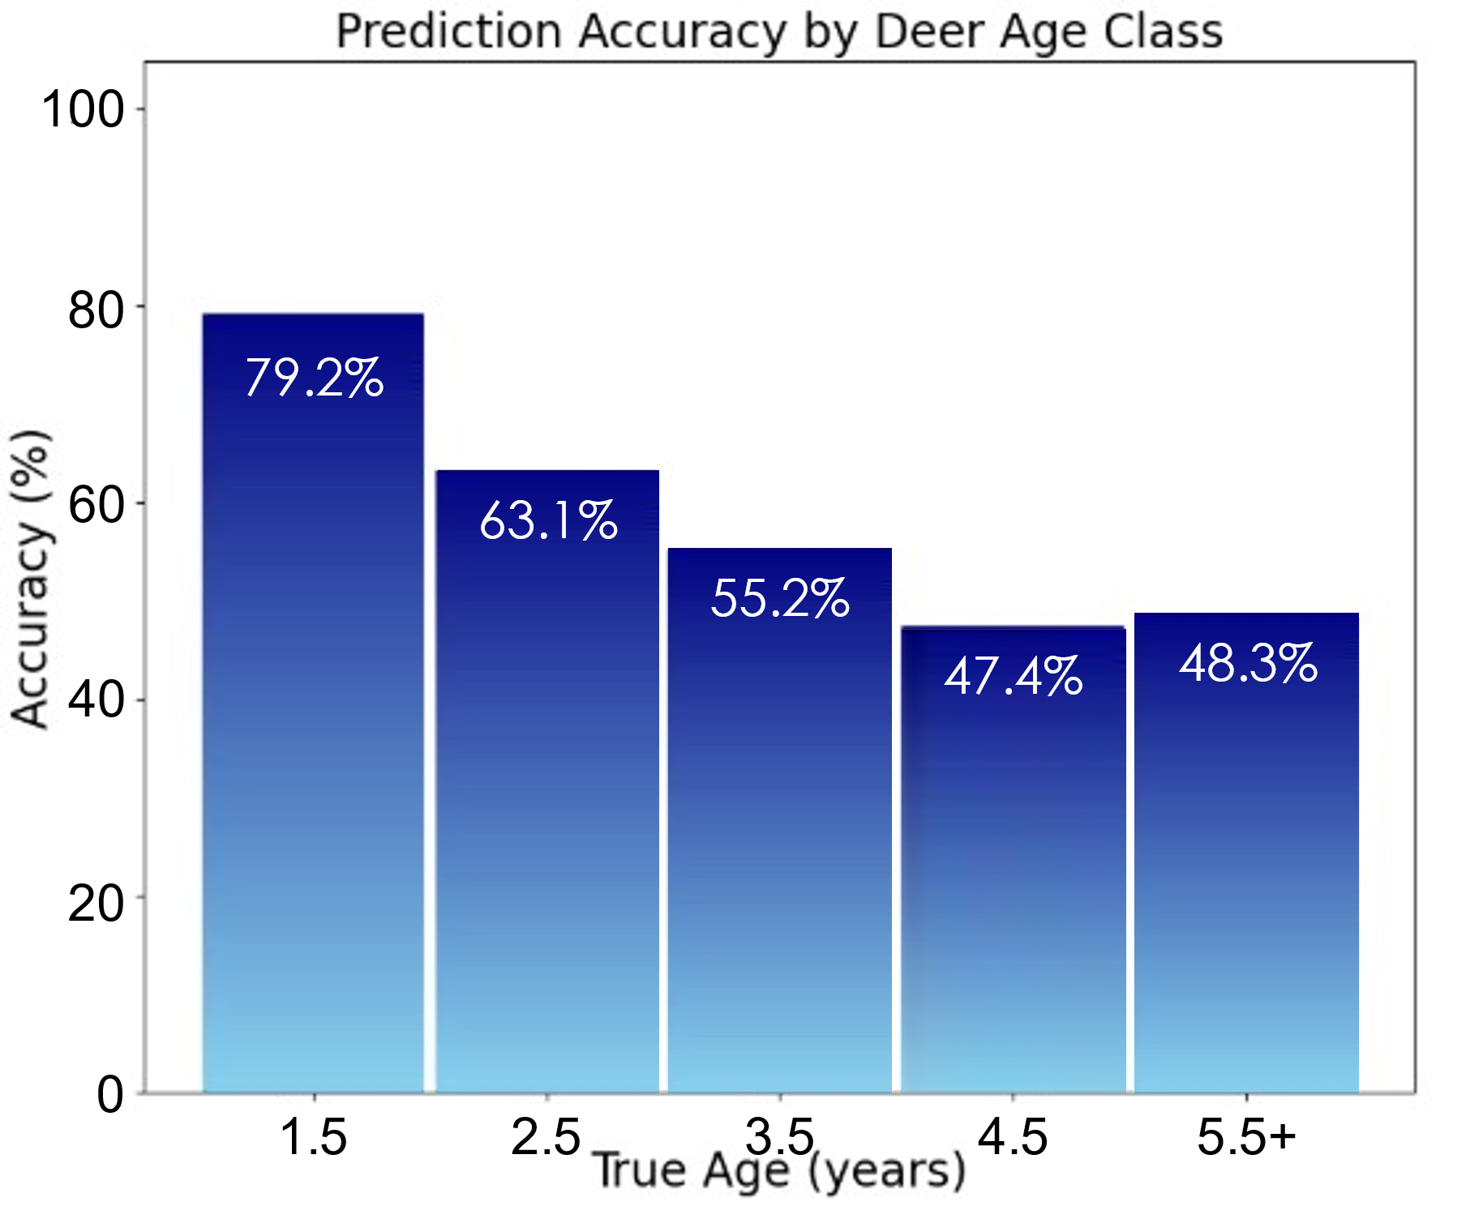
Data : Accuracy Analysis
Over time, accuracy statistics reveal reader prediction trends
Readers are best at predicting young ages
Readers are worst at predicting old ages
The most difficult age to predict is 4.5 yrs
Notes:
In addition to other resources (ex. Youtube, Facebook, etc.), the National Deer Association’s “Age This!” surveys provide much of the initial data.
Each week, results from the previous week’s survey provide two items:
An aged deer photo with explanation of why the decision was made
Statistics on how others voted for the previous week’s survey.
The former provides images, its metadata stored within the filename for each image.
The latter provides statistics for human prediction accuracy, also collected for each image.

Slide 8
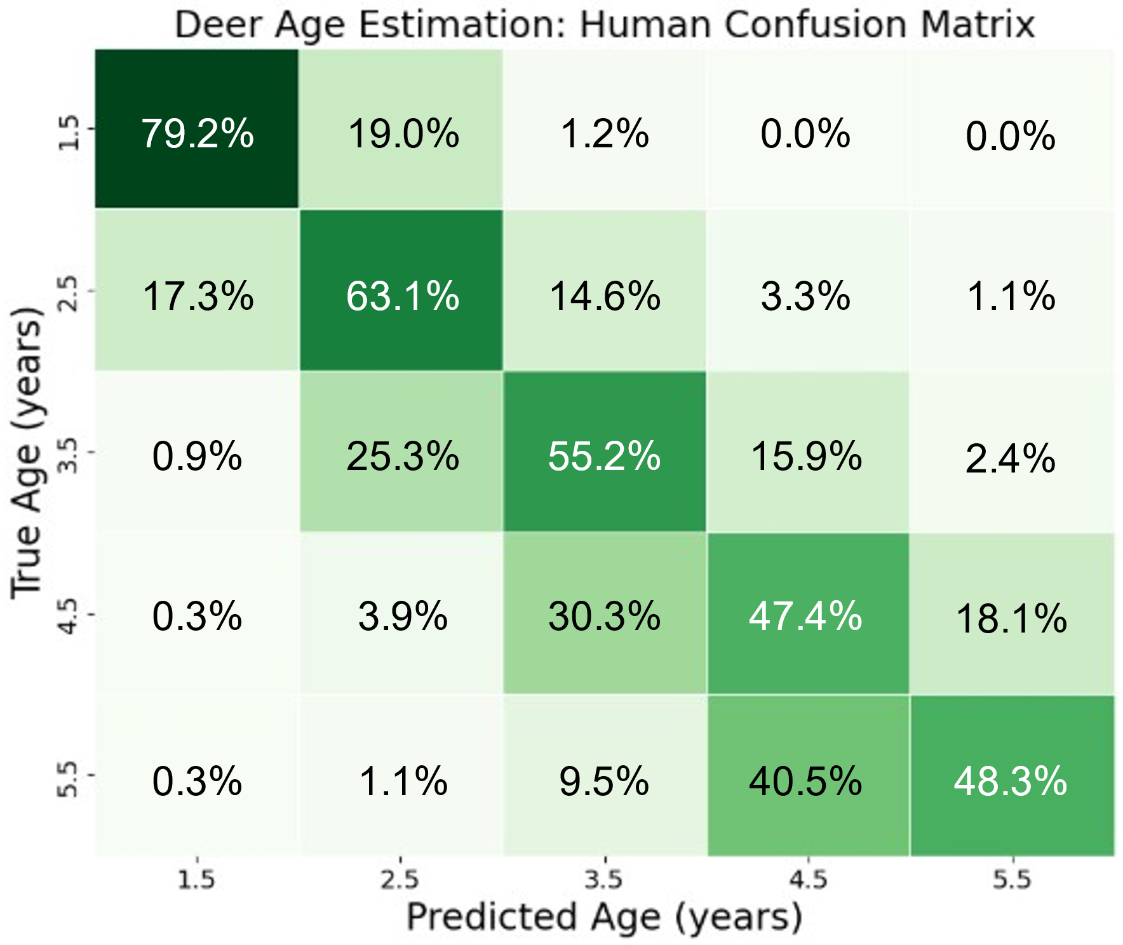
Data : Accuracy Analysis
Over time, accuracy statistics reveal reader prediction trends
Readers are best at predicting young ages
Readers are worst at predicting old ages
The most difficult age to predict is 4.5 yrs
The confusion matrix shows details reader prediction errors
When wrong, readers tend to guess young
For 5.5+ yrs, readers are ~50% split between 4.5 and 5.5+
Notes:
In addition to other resources (ex. Youtube, Facebook, etc.), the National Deer Association’s “Age This!” surveys provide much of the initial data.
Each week, results from the previous week’s survey provide two items:
An aged deer photo with explanation of why the decision was made
Statistics on how others voted for the previous week’s survey.
The former provides images, its metadata stored within the filename for each image.
The latter provides statistics for human prediction accuracy, also collected for each image.

Slide 9
Data : Accuracy Analysis
Over time, accuracy statistics reveal reader prediction trends
Readers are best at predicting young ages
Readers are worst at predicting old ages
The most difficult age to predict is 4.5 yrs
The confusion matrix shows details reader prediction errors
When wrong, readers tend to guess young
For 5.5+ yrs, readers are ~50% split between 4.5 and 5.5+
Readers are better than random guessing, but not accurate enough for research (80%)
Random guess accuracy: 20.00%
Avg. human accuracy: 58.64%
Majority vote accuracy: 74.17%
Notes:
In addition to other resources (ex. Youtube, Facebook, etc.), the National Deer Association’s “Age This!” surveys provide much of the initial data.
Each week, results from the previous week’s survey provide two items:
An aged deer photo with explanation of why the decision was made
Statistics on how others voted for the previous week’s survey.
The former provides images, its metadata stored within the filename for each image.
The latter provides statistics for human prediction accuracy, also collected for each image.

Slide 10
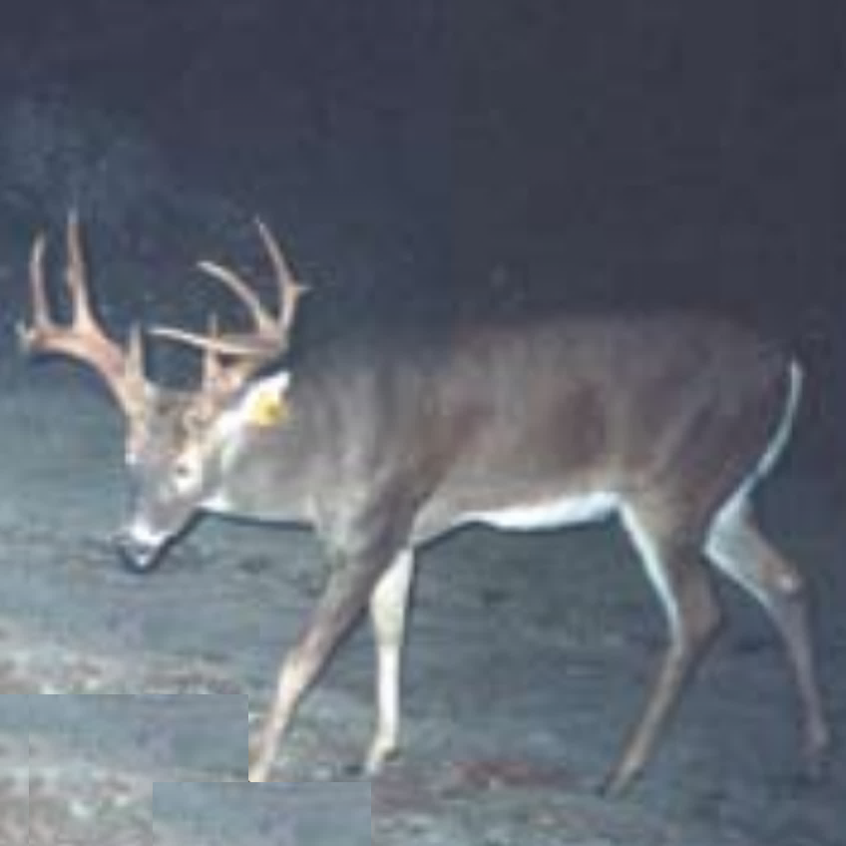
Data Standardization
Similar to Age This! readers, machine learning begins by building a dataset from the survey
Each image in the dataset is cropped to match the input of the machine learning model
250116_241016_VA_2p5_NDA.png
Notes:
We know a priori that computer vision models like ResNet expect square images of 224x224 resolution.
Therefore, initial images are captured, cropped, and formatted to fit the 1:1 aspect ratio requirements.
Cropping is done with respect to the deer’s body, not the antlers or background
This forces the model to only consider body composition, dimensions, and pose rather than antler size or location.

Slide 11
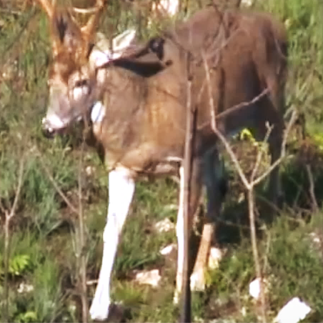
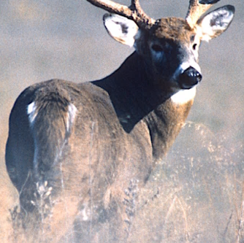
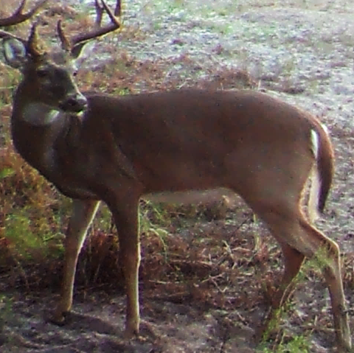
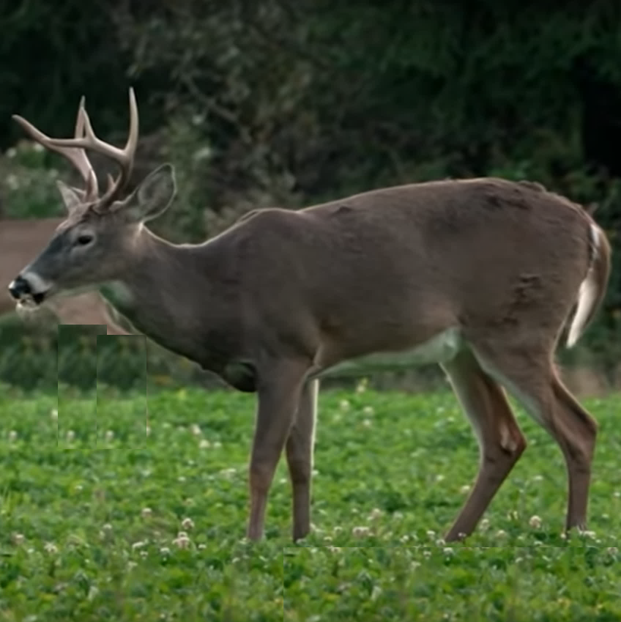
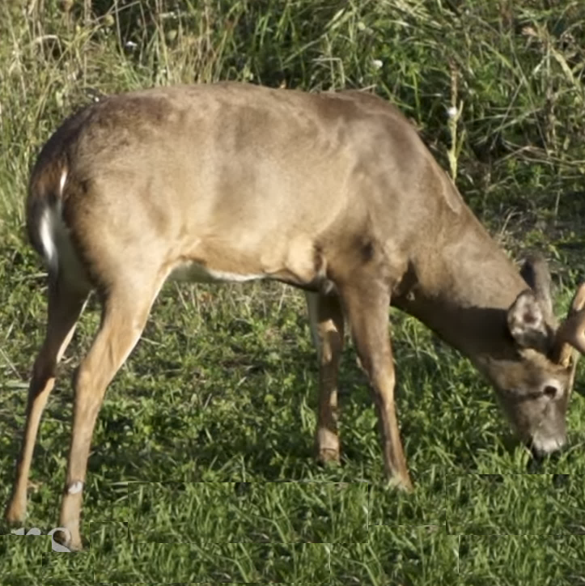
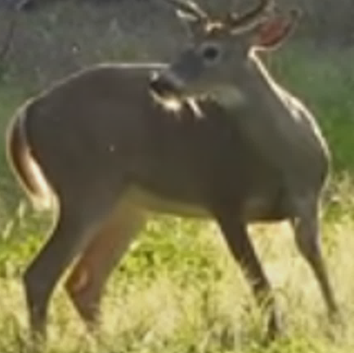
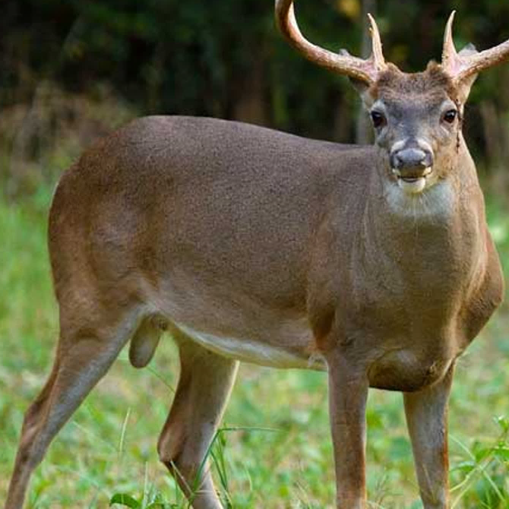
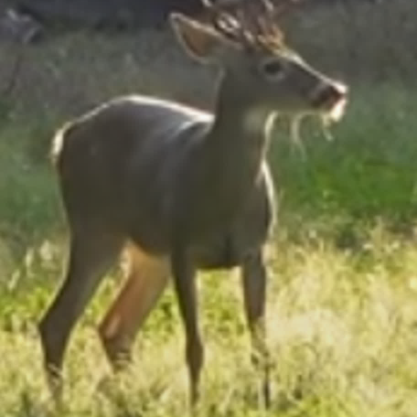
Data Preparation
Similar to Age This! readers, machine learning begins by building a dataset from the survey
Each image in the dataset is cropped to match the input of the machine learning model
Additional data is also gathered from NDA posters and YouTube AOTH videos
224
224
Notes:
During model execution, Python collects the square-cropped images, interpolating each image to 224x224 (the image size expected by ResNet)
Examples of deer in different backgrounds, poses, ages, and locations are shown, illustrating the diversity of the dataset.

Slide 12
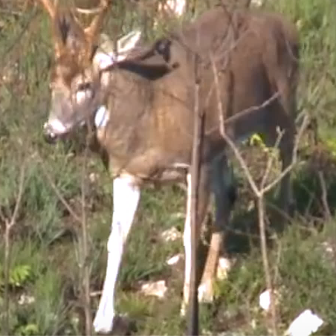
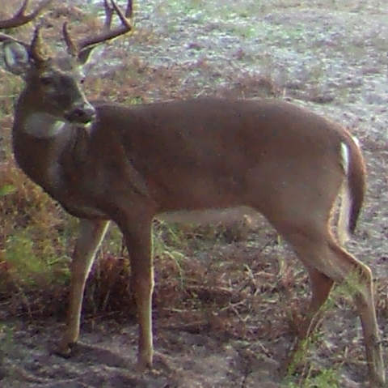
Model Training
Similar to Age This! readers, machine learning begins by building a dataset from the survey
Each image in the dataset is cropped to match the input of the machine learning model
Additional data is also gathered from NDA posters and YouTube AOTH videos
The dataset is split into training, validation, and test data which the model never sees
Training and validation data are used to optimize a group of models that work together
Train
Validation
Test
Ensemble
. . .
Fold 1
Aug.
RN 1
Evaluate
Fold 5
Aug.
RN 5
Tuned ensemble
Notes:
During model execution, Python collects the square-cropped images, interpolating each image to 224x224 (the image size expected by ResNet)
Examples of deer in different backgrounds, poses, ages, and locations are shown, illustrating the diversity of the dataset.

Slide 13
Model Validation
Similar to Age This! readers, machine learning begins by building a dataset from the survey
Each image in the dataset is cropped to match the input of the machine learning model
Additional data is also gathered from NDA posters and YouTube AOTH videos
The dataset is split into training, validation, and test data which the model never sees
Training and validation data are used to optimize a group of models that work together
The result is a fully trained ensemble model capable of providing deer age and confidence
Finally, test data is fed to the model to gauge its accuracy on data it has never seen before
Train
Validation
Test
Tuned ensemble
Inference
Error analysis
Notes:
During model execution, Python collects the square-cropped images, interpolating each image to 224x224 (the image size expected by ResNet)
Examples of deer in different backgrounds, poses, ages, and locations are shown, illustrating the diversity of the dataset.

Slide 14
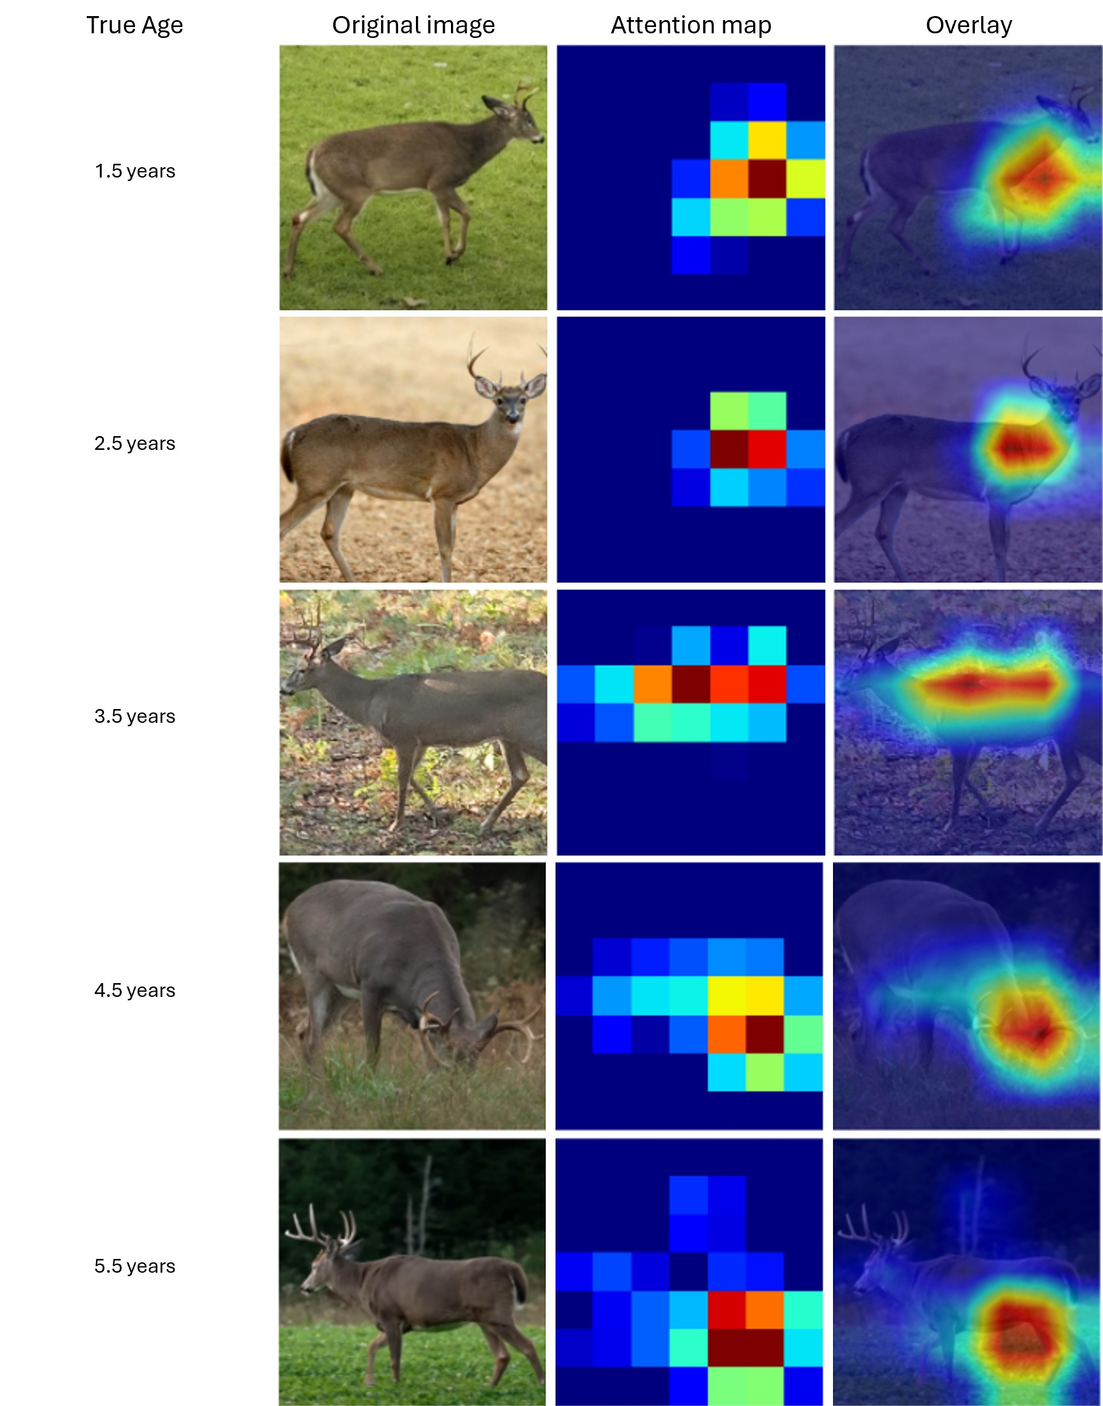
Model Output
Similar to Age This! readers, machine learning begins by building a dataset from the survey
Each image in the dataset is cropped to match the input of the machine learning model
Additional data is also gathered from NDA posters and YouTube AOTH videos
The dataset is split into training, validation, and test data which the model never sees
Training and validation data are used to optimize a group of models that work together
The result is a fully trained ensemble model capable of providing deer age and confidence
Finally, test data is fed to the model to gauge its accuracy on data it has never seen before
New data fed to the model produces age estimates, confidence, and attention maps
2.5 yrs old
87.3% confident
Tuned ensemble
Notes:
During model execution, Python collects the square-cropped images, interpolating each image to 224x224 (the image size expected by ResNet)
Examples of deer in different backgrounds, poses, ages, and locations are shown, illustrating the diversity of the dataset.

Slide 15
Attention maps
Attention maps are created by the model, showing features it uses to make predictions
1.5 yr olds – attention is placed on the neck and chest, a common characteristic noted by NDA
2.5 yr olds – attention is still placed on the neck and chest, common to written justifications
5.5 yr olds – attention is placed on the stomach region, matching AgeThis! survey descriptions
The model is extract purely biological features regardless of background, pose, or age
Raw image
Attention Map
1.5 yrs
2.5 yrs
5.5+ yrs

Slide 16
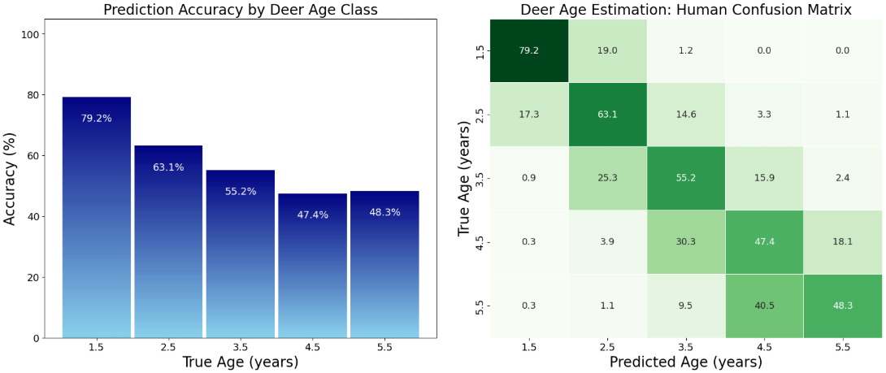
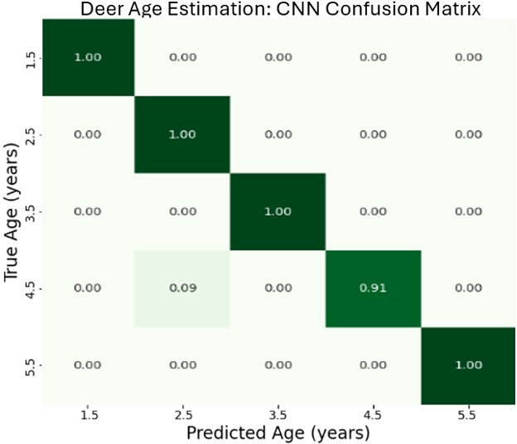
Accuracy Comparison
Attention maps are created by the model, showing features it uses to make predictions
1.5 yr olds – attention is placed on the neck and chest, a common characteristic noted by NDA
2.5 yr olds – attention is still placed on the neck and chest, common to written justifications
5.5 yr olds – attention is placed on the stomach region, matching AgeThis! survey descriptions
The model is extract purely biological features regardless of background, pose, or age
The model’s accuracy is notably greater than accuracies from the survey
One interesting exception is the model’s mistaking a 4.5 y.o. buck for 2.5 y.o. buck
(9.0% mistake rate for the model, 3.9% mistake rate for readers)
Reader performance
100
79.2%
19.0%
1.2%
0.0%
0.0%
80
79.2%
17.3%
63.1%
14.6%
3.3%
1.1%
60
63.1%
55.2%
0.9%
25.3%
55.2%
15.9%
2.4%
40
47.4%
48.3%
0.3%
3.9%
30.3%
47.4%
18.1%
20
0.3%
1.1%
9.5%
40.5%
48.3%
0
1.5
2.5
3.5
4.5
5.5+
Model performance
Deer Age Estimation: CNN Confusion Matrix
100
100%
0.0%
0.0%
0.0%
0.0%
79.2%
19.0%
1.2%
0.0%
0.0%
80
0.0%
100%
0.0%
0.0%
0.0%
17.3%
63.1%
14.6%
3.3%
1.1%
60
0.0%
0.0%
100%
0.0%
0.0%
0.9%
25.3%
55.2%
15.9%
2.4%
40
0.0%
9.0%
0.0%
91.0%
0.0%
0.3%
3.9%
30.3%
47.4%
18.1%
20
0.3%
1.1%
9.5%
40.5%
0.0%
0.0%
0.0%
0.0%
48.3%
100%
0
1.5
2.5
3.5
4.5
5.5+
Notes:
During model execution, Python collects the square-cropped images, interpolating each image to 224x224 (the image size expected by ResNet)
Examples of deer in different backgrounds, poses, ages, and locations are shown, illustrating the diversity of the dataset.

Slide 17
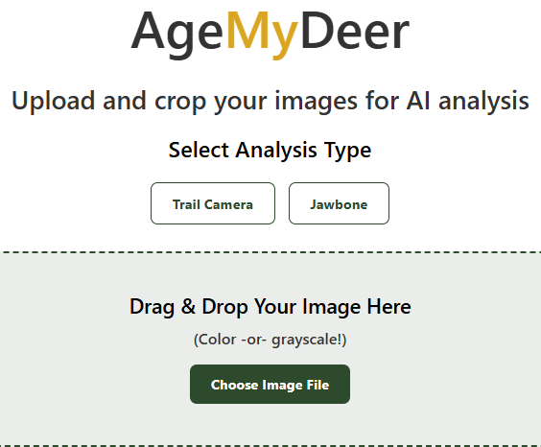
Model Deployment
The tool, AgeMyDeer, is available for use at: www.agemydeer.com
The website provides two image-based aging capabilities: trail camera and jawbone.
Readers can drag and drop any deer photo (color or grayscale) into the image box.
Notes:
During model execution, Python collects the square-cropped images, interpolating each image to 224x224 (the image size expected by ResNet)
Examples of deer in different backgrounds, poses, ages, and locations are shown, illustrating the diversity of the dataset.

Slide 18
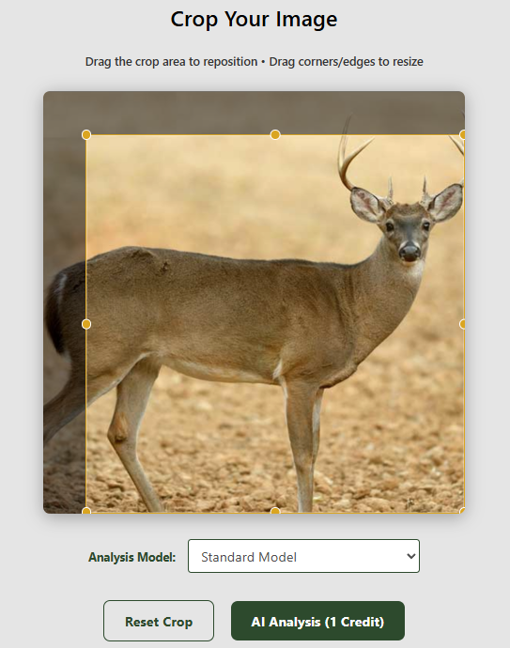
Model Deployment
The tool, AgeMyDeer, is available for use at: www.agemydeer.com
The website provides two image-based aging capabilities: trail camera and jawbone.
Readers can drag and drop any deer photo (color or grayscale) into the image box.
The image is uploaded and the reader is asked to choose a square crop for the image.
Notes:
During model execution, Python collects the square-cropped images, interpolating each image to 224x224 (the image size expected by ResNet)
Examples of deer in different backgrounds, poses, ages, and locations are shown, illustrating the diversity of the dataset.

Slide 19
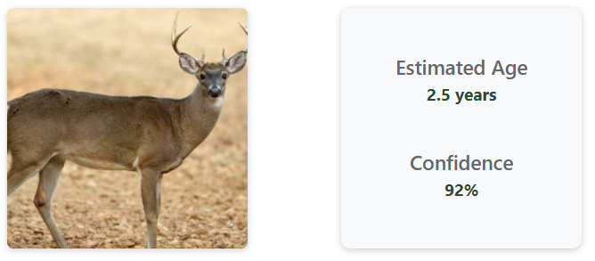
Model Deployment
The tool, AgeMyDeer, is available for use at: www.agemydeer.com
The website provides two image-based aging capabilities: trail camera and jawbone.
Readers can drag and drop any deer photo (color or grayscale) into the image box.
The image is uploaded and the reader is asked to choose a square crop for the image.
In less than 15 seconds, the cropped image is displayed with a predicted age and confidence
Notes:
During model execution, Python collects the square-cropped images, interpolating each image to 224x224 (the image size expected by ResNet)
Examples of deer in different backgrounds, poses, ages, and locations are shown, illustrating the diversity of the dataset.

Slide 20
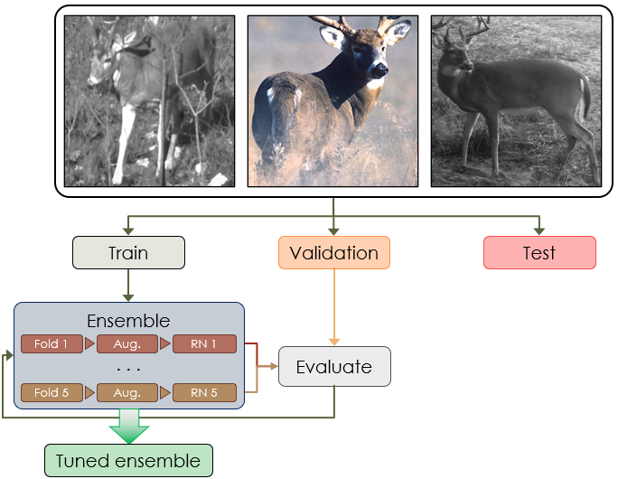
Conclusion
AgeMyDeer is the first machine learning model
Notes:
During model execution, Python collects the square-cropped images, interpolating each image to 224x224 (the image size expected by ResNet)
Examples of deer in different backgrounds, poses, ages, and locations are shown, illustrating the diversity of the dataset.

Slide 21
Extra images

Slide 22
ResNet-18
Model 1
Fold 1
Model 1 TTA (Original + Flip) → Avg. Prediction
ResNet-18
Model 2
Fold 2
Model 2 TTA (Original + Flip) → Avg. Prediction
Original image
Input
224 x 224 x 3
Deer image
ResNet-18
Model 3
Fold 3
Model 3 TTA (Original + Flip) → Avg. Prediction
Ensemble Agg.
SoftMax average
Final Prediction
Flipped image
ResNet-18
Model 4
Fold 4
Model 4 TTA (Original + Flip) → Avg. Prediction
ResNet-18
Model 5
Fold 5
Model 5 TTA (Original + Flip) → Avg. Prediction
Date | Model | Img size | Img type | Validation | Test | Metric | Filename
7/2/25 | Ensemble | 244 x 244 | Color | - | - | - | trailcam_ensemble
9/18/25 | EfficientNet-B5 | 512 x 512 | BW / Color | 80.4% | 78.4% | 0.63 | 251809_enb5

Slide 23
Train
Validation
Test
Ensemble
. . .
Fold 1
Aug.
RN 1
Evaluate
Fold 5
Aug.
RN 5
Tuned ensemble

